Slide 1
SharePoint 2010 & PowerShell: Tips, Tricks, and Random Goodness
Gary Lapointe
Director, Aptillon, Inc.
SharePoint MVP

Slide 2
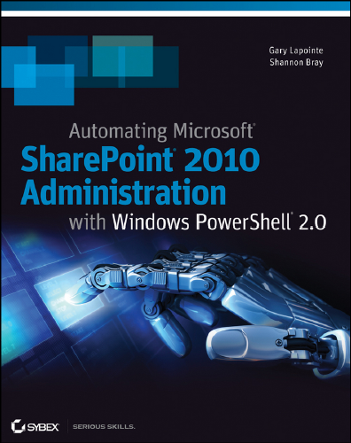
About Me
Aptillon, Inc.
Director and Founding Partner
http://www.aptillon.com
SharePoint MVP since January 2008
Blog: http://blog.falchionconsulting.com
Twitter: @glapointe

Slide 3
Load Snap-in For any Editor
Notes:
if (!(Test-Path $profile.AllUsersAllHosts)) {
New-Item -Type file -Path $profile.AllUsersAllHosts -Force
}
$sb = @"
if (`$host.UI.RawUI.WindowTitle -ne "Administrator: SharePoint 2010 Management Shell") {
`$ver = `$host | select version
if (`$ver.Version.Major -gt 1) {`$host.Runspace.ThreadOptions = "ReuseThread"}
if ((Get-PSSnapin "Microsoft.SharePoint.PowerShell" -ErrorAction SilentlyContinue) -eq `$null) {
Add-PSSnapin "Microsoft.SharePoint.PowerShell"
}
}
"@
Set-Content -Path $profile.AllUsersAllHosts -Value $sb

Slide 4
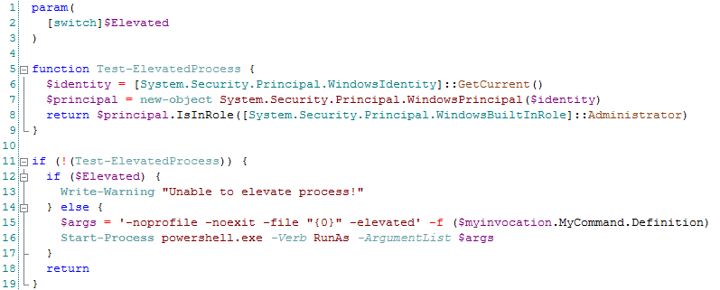
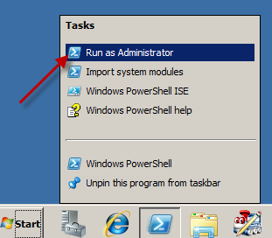
Run Elevated
Notes:
param(
[switch]$Elevated
)
function Test-ElevatedProcess {
$identity = [System.Security.Principal.WindowsIdentity]::GetCurrent()
$principal = new-object System.Security.Principal.WindowsPrincipal($identity)
return $principal.IsInRole([System.Security.Principal.WindowsBuiltInRole]::Administrator)
}
if (!(Test-ElevatedProcess)) {
if ($Elevated) {
Write-Warning "Unable to elevate process!"
} else {
$args = '-noprofile -noexit -file "{0}" -elevated' -f ($myinvocation.MyCommand.Definition)
Start-Process powershell.exe -Verb RunAs -ArgumentList $args
}
return
}

Slide 5
Finding Help
Documentation: help <cmdlet name>
Discovery:
Get-Command
Get-Member
Get-Verb

Slide 6
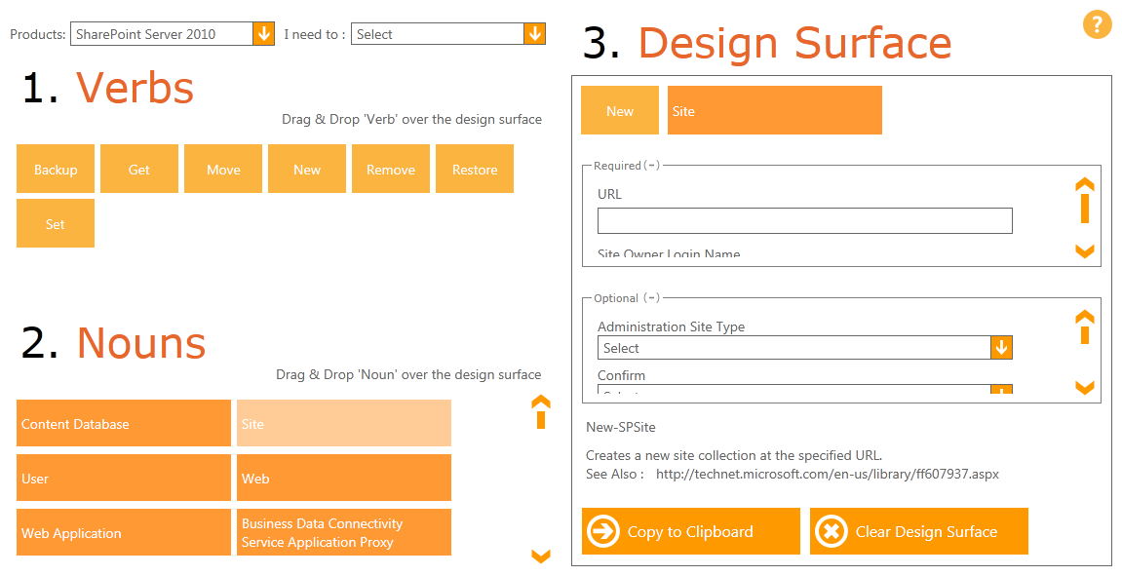
PowerShell Command Builder
http://technet.microsoft.com/en-us/sharepoint/ff603532

Slide 7
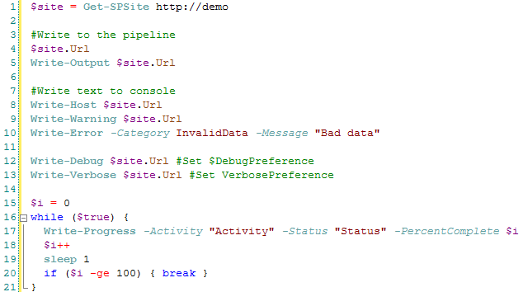
Know Your Output Options
Exact same thing
Not like throwing an exception!
help about_Preference_Variables
Notes:
$site = Get-SPSite http://demo
#Write to the pipeline
$site.Url
Write-Output $site.Url
#Write text to console
Write-Host $site.Url
Write-Warning $site.Url
Write-Error -Category InvalidData -Message "Bad data"
Write-Debug $site.Url #Set $DebugPreference
Write-Verbose $site.Url #Set VerbosePreference
$i = 0
while ($true) {
Write-Progress -Activity "Activity" -Status "Status" -PercentComplete $i
$i++
sleep 1
if ($i -ge 100) { break }
}

Slide 8
Fancy Output
Baloon Tips
Text to Speech
Notes:
function Set-BallonTip($title, $text) {
[System.Reflection.Assembly]::LoadWithPartialName("System.Windows.Forms") | Out-Null
$balloon = New-Object System.Windows.Forms.NotifyIcon
$path = (Get-Process -Id $pid).Path
$balloon.Icon = [System.Drawing.Icon]::ExtractAssociatedIcon($path)
$balloon.BalloonTipIcon = "Info"
$balloon.BalloonTipText = $text
$balloon.BalloonTipTitle = $title
$balloon.Visible = $true
$balloon.ShowBalloonTip(10000)
}
function Out-Speech($text, $async = $true) {
[System.Reflection.Assembly]::LoadWithPartialName("System.Speech") | Out-Null
$synth = New-Object System.Speech.Synthesis.SpeechSynthesizer
if ($async) {
$synth.SpeakAsync($text) | Out-Null
} else {
$synth.Speak($text) | Out-Null
}
}
Out-Speech "Don't Panic!"

Slide 9
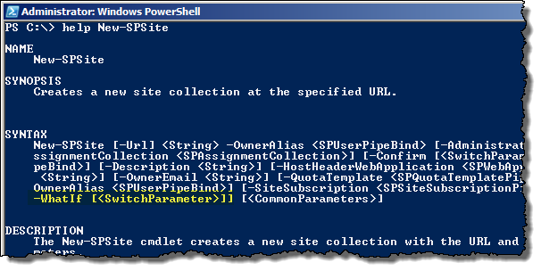
WhatIf???

Slide 10
Negating Switch Statements
Bug: Enables Kerberos
Omitting will disable Kerberos

Slide 11
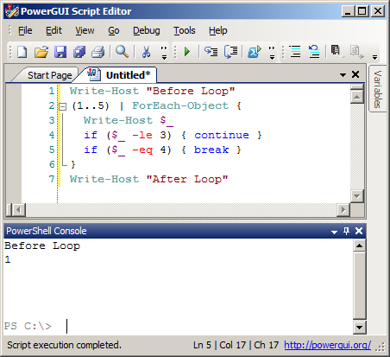
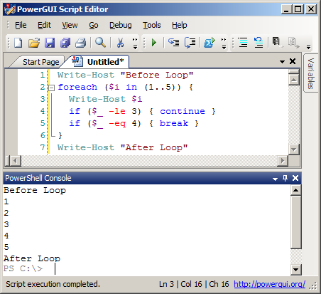
Don’t Use ForEach-Object in Scripts
Notes:
Write-Host "Before Loop"
(1..5) | ForEach-Object {
Write-Host $_
if ($_ -le 3) { continue }
if ($_ -eq 4) { break }
}
Write-Host "After Loop“
Write-Host "Before Loop"
foreach ($i in (1..5)) {
Write-Host $i
if ($_ -le 3) { continue }
if ($_ -eq 4) { break }
}
Write-Host "After Loop"

Slide 12
Test Loops & Conditions Before Making Changes
But Wait! What’s wrong with this example?!?!
Notes:
foreach ($web in (Get-SPSite -Limit All | Get-SPWeb -Limit All)) {
foreach ($list in $web.GetListsOfType("DocumentLibrary")) {
Write-Host "$($list.Url) => $($list.EnableVersioning)"
if ($list.EnableVersioning) {
Write-Host "`tChanging major version limit..."
#$list.MajorVersionLimit = 10
#$list.Update()
}
}
}

Slide 13
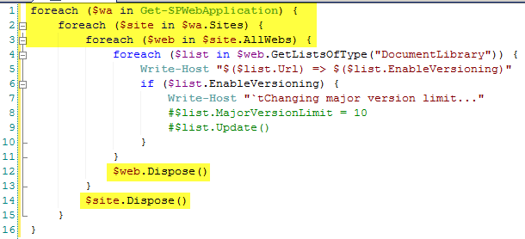
Objects Need to be Disposed!
Don’t rely on the SPAssignmentCollection!
Notes:
foreach ($wa in Get-SPWebApplication) {
foreach ($site in $wa.Sites) {
foreach ($web in $site.AllWebs) {
foreach ($list in $web.GetListsOfType("DocumentLibrary")) {
Write-Host "$($list.Url) => $($list.EnableVersioning)"
if ($list.EnableVersioning) {
Write-Host "`tChanging major version limit..."
#$list.MajorVersionLimit = 10
#$list.Update()
}
}
$web.Dispose()
}
$site.Dispose()
}
}

Slide 14
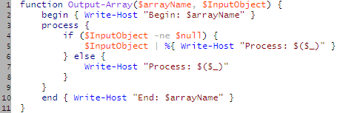
Functions Can Support the Pipeline!
Be Careful! Extra Work is Needed for normal function calls!

Slide 15
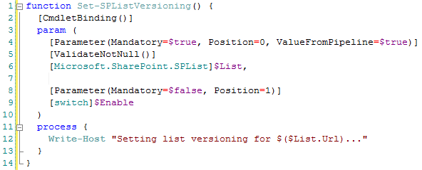
Use Advanced Parameters
Type help about_functions_advanced_parameters for more examples
Notes:
function Set-SPListVersioning() {
[CmdletBinding()]
param (
[Parameter(Mandatory=$true, Position=0, ValueFromPipeline=$true)]
[ValidateNotNull()]
[Microsoft.SharePoint.SPList]$List,
[Parameter(Mandatory=$false, Position=1)]
[switch]$Enable
)
process {
Write-Host "Setting list versioning for $($List.Url)..."
}
}
(Get-SPWeb http://demo).Lists | Set-SPListVersioning -Enable
Set-SPListVersioning -List (Get-SPList http://demo/pages) -Enable

Slide 16
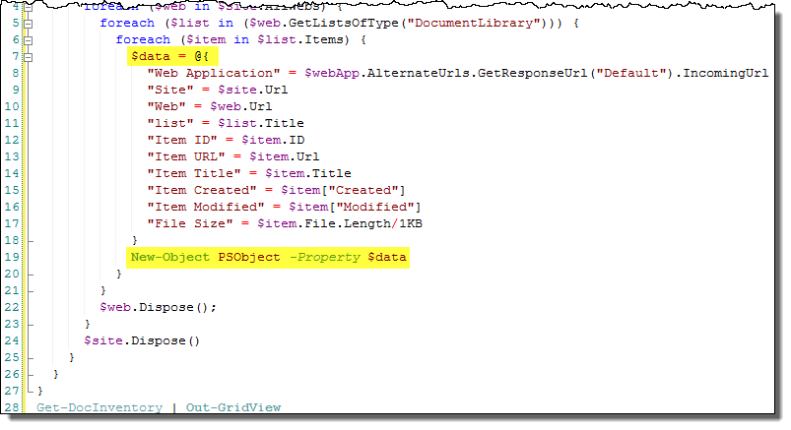
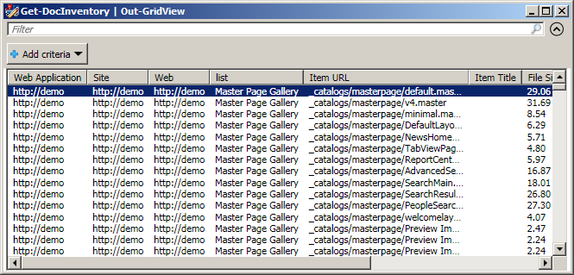
Create Dynamic Objects for Complex Output (as opposed to Select-Object)
Notes:
function Get-DocInventory() {
foreach ($webApp in (Get-SPWebApplication http://demo)) {
foreach ($site in $webApp.Sites) {
foreach ($web in $site.AllWebs) {
foreach ($list in ($web.GetListsOfType("DocumentLibrary"))) {
foreach ($item in $list.Items) {
$item | select `
@{e={$webApp.AlternateUrls.GetResponseUrl("Default").IncomingUrl};l="Web App"}, `
@{e={$site.Url};l="Site"}, `
@{e={$web.Url};l="Web"}, `
ID, `
Url, `
Title, `
@{e={$item["Created"]};l="Created"}, `
@{e={$item["Modified"]};l="Modified"}, `
@{e={$item.File.Length/1KB};l="File Size"}
# $data = @{
# "Web Application" = $webApp.AlternateUrls.GetResponseUrl("Default").IncomingUrl
# "Site" = $site.Url
# "Web" = $web.Url
# "list" = $list.Title
# "Item ID" = $item.ID
# "Item URL" = $item.Url
# "Item Title" = $item.Title
# "Item Created" = $item["Created"]
# "Item Modified" = $item["Modified"]
# "File Size" = $item.File.Length/1KB
# }
# New-Object PSObject -Property $data
}
}
$web.Dispose();
}
$site.Dispose()
}
}
}
Get-DocInventory | Out-GridView

Slide 17
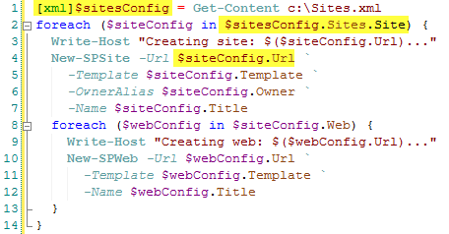
Adaptive Type System: XML
Notes:
<Sites>
<Site Url="http://demo/sites/Site1" Title="Site 1" Template="STS#0" Owner="aptillon\spadmin">
<Web Url="http://demo/sits/Site1/SubWeb1" Title="Sub-Web 1" Template="STS#0" />
<Web Url="http://demo/sits/Site1/SubWeb2" Title="Sub-Web 2" Template="STS#0" />
</Site>
<Site Url="http://demo/sites/Site2" Title="Site 2" Template="STS#0" Owner="aptillon\spadmin">
<Web Url="http://demo/sits/Site2/SubWeb1" Title="Sub-Web 1" Template="STS#0" />
</Site>
</Sites>
[xml]$sitesConfig = Get-Content c:\Sites.xml
foreach ($siteConfig in $sitesConfig.Sites.Site) {
Write-Host "Creating site: $($siteConfig.Url)..."
New-SPSite -Url $siteConfig.Url `
-Template $siteConfig.Template `
-OwnerAlias $siteConfig.Owner `
-Name $siteConfig.Title
foreach ($webConfig in $siteConfig.Web) {
Write-Host "Creating web: $($webConfig.Url)..."
New-SPWeb -Url $webConfig.Url `
-Template $webConfig.Template `
-Name $webConfig.Title
}
}

Slide 18
Splatting
Provides cmdlet properties via a hash table
Create a hash table:
$varname = @{"key"=value;…}
Pass to cmdlet as @varname
New-SPSite @varname
Notes:
function New-GLSite($Url, $Template, $Name) {
$site = Get-SPSite $Url -ErrorAction SilentlyContinue
if ($site -ne $null) { return $site }
New-SPSite -OwnerAlias "aptillon\spadmin" @PSBoundParameters
}

Slide 19
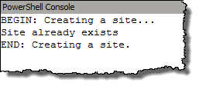
Executing Script Block Variables
Notes:
function Write-Trace($task, $code) {
Write-Host "BEGIN: $task..."
&$code
Write-Host "END: $task."
}
Write-Trace "Creating a site" {
if ((Get-SPSite http://demo) -eq $null) {
New-SPSite -Url http://demo -Template "STS#0" -Name "Demo Site" -OwnerAlias "aptillon\spadmin"
} else {
Write-Host "Site already exists"
}
}

Slide 20
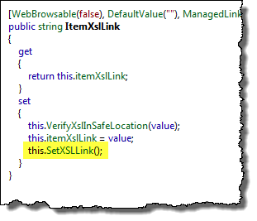
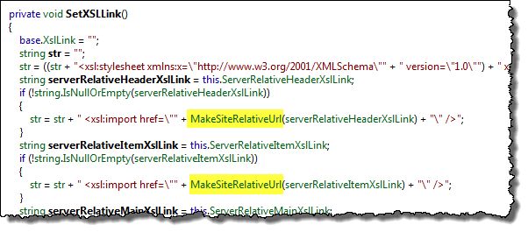
Null HTTP Context
Notes:
function Set-HttpContext($web) {
[System.Web.HttpRequest]$httpRequest = New-Object System.Web.HttpRequest "", $web.Url, ""
[System.IO.StringWriter]$writer = New-Object System.IO.StringWriter
[System.Web.HttpResponse]$httpResponse = New-Object System.Web.HttpResponse $writer
$httpContext = New-Object System.Web.HttpContext $httpRequest, $httpResponse
[System.Web.HttpContext]::Current = $httpContext
[Microsoft.SharePoint.WebControls.SPControl]::SetContextSite($httpContext, $web.Site)
[Microsoft.SharePoint.WebControls.SPControl]::SetContextWeb($httpContext, $web)
$site.RootWeb.AllowUnsafeUpdates = $true
$httpContext.Items["FormDigestValidated"] = $true
$httpContext.User = [System.Threading.Thread]::CurrentPrincipal
$httpContext.Items["Microsoft.SharePoint.SPServiceContext"] = [Microsoft.SharePoint.SPServiceContext]::Default
}

Slide 21
Watch for Cached Assemblies
When activating Features via PowerShell, close your PowerShell session after each updated Solution deployment
Applies to any references to code that have been updated, not just Features (but Features are the more common scenario)

Slide 22
Enabling Remoting
Run Enable-PsRemoting on the client and server machines
Must Enable CredSSP on client and server machines
Client: Enable-WSmanCredSSP -Role Client -DelegateComputer <remote server name>
Server: Enable-WSmanCredSSP -Role Server
Increase the MaxMemoryPerShellMB setting on server (default is 150MB)
Set-Item WSMan:\localhost\Shell\MaxMemoryPerShellMB 1024
Decrease MaxShellsPerUser and MaxConcurrentUsers (default is 5)
Set-Item WSMan:\localhost\shell\MaxShellsPerUser 2
Set-Item WSMan:\localhost\shell\MaxConcurrentUsers 2

Slide 23
Remoting Session Configurations
Use Register-PSSessionConfiguration to preload SharePoint PowerShell Snap-In
Must also set threading options
Use Set-PSSessionConfiguration with -ShowSecurityDescriptorUI parameter to set security
Provide configuration name when calling New-PSSession
Notes:
Get-PSSessionConfiguration
Register-PSSessionConfiguration -Name "SharePoint" `
-StartupScript "C:\Program Files\Common Files\Microsoft Shared\Web Server Extensions\14\CONFIG\POWERSHELL\Registration\sharepoint.ps1" `
-Force -ThreadOptions ReuseThread
Set-PSSessionConfiguration -Name "SharePoint" -ShowSecurityDescriptorUI -Force
$session = New-PSSession -ComputerName $server -Authentication CredSSP -Credential $cred -ConfigurationName "SharePoint"

Slide 24
Additional Resources
http://blog.falchionconsulting.com
Buy my book ☺
PowerShell.com
lots of good tips
PowerShell Cheat Sheet:
http://tinyurl.com/3hgtfke

Slide 25
About Aptillon
SharePoint MVPs
Microsoft Certified Master
Consultants, Trainers, Authors, Speakers, Bloggers
Great People, Great Experience, Great Passion
Todd Baginski
David Mann
Gary Lapointe
Darrin Bishop
Maurice Prather
Dan Holme
Matthew McDermott

Slide 26
Questions?

