Slide 1
Taxonomy Based Content Targeting for a SharePoint Internet Site
Gary Lapointe
Director, Aptillon, Inc.
SharePoint MVP

Slide 2
About Me
Aptillon, Inc.
Director and Founding Partner
http://www.aptillon.com
SharePoint MVP since January 2008
Blog: http://blog.falchionconsulting.com
Twitter: @glapointe

Slide 3
Agenda
Case Study: Visio Marketing Site
Managed Term Store and Taxonomy Fields
Customizing the Content By Query Web Part

Slide 4
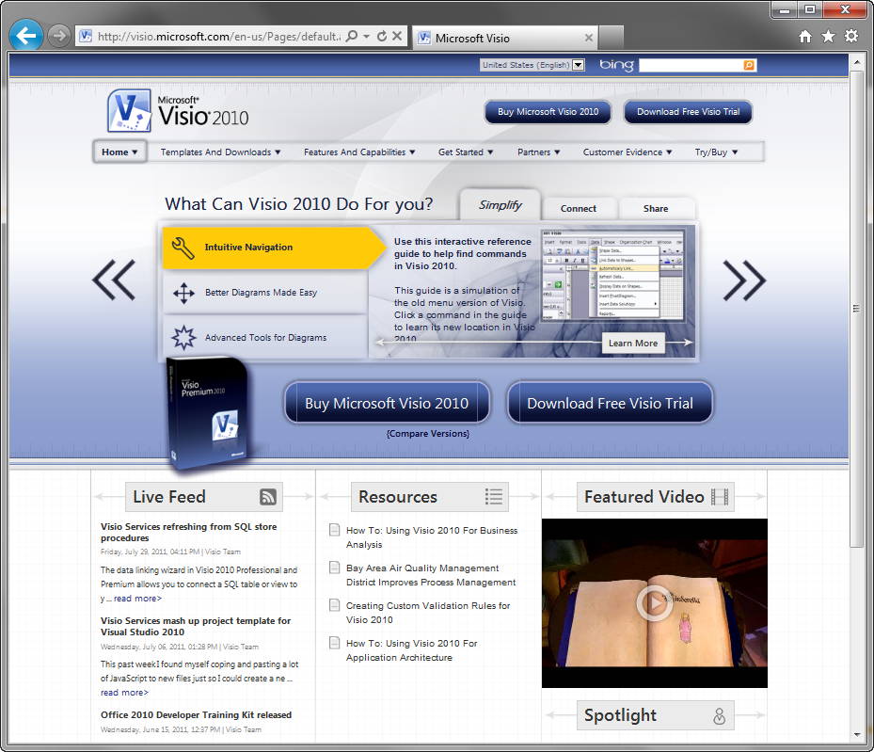
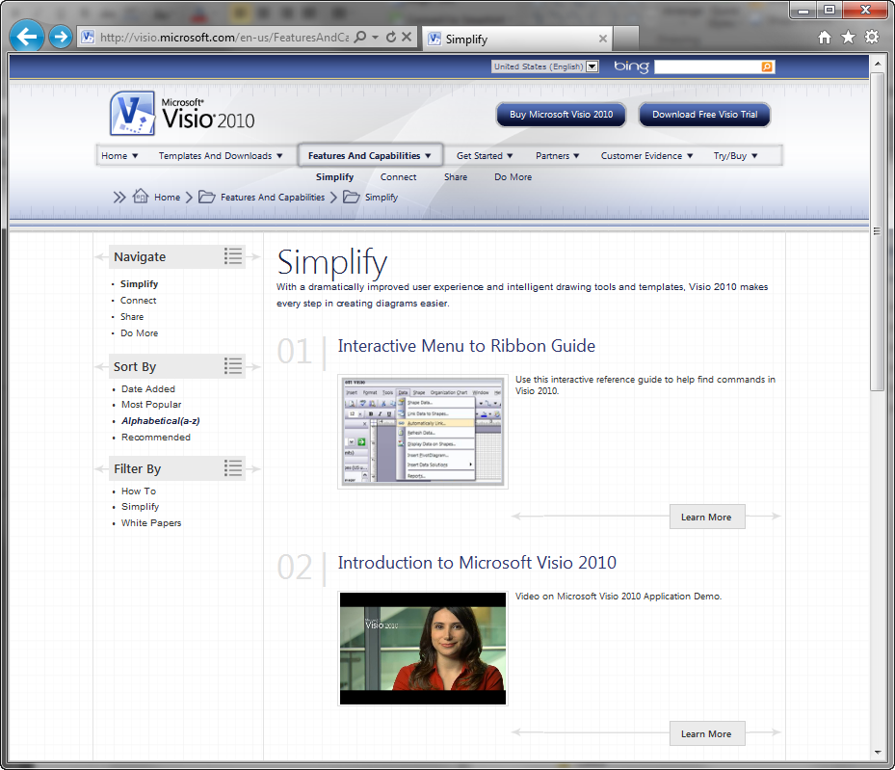
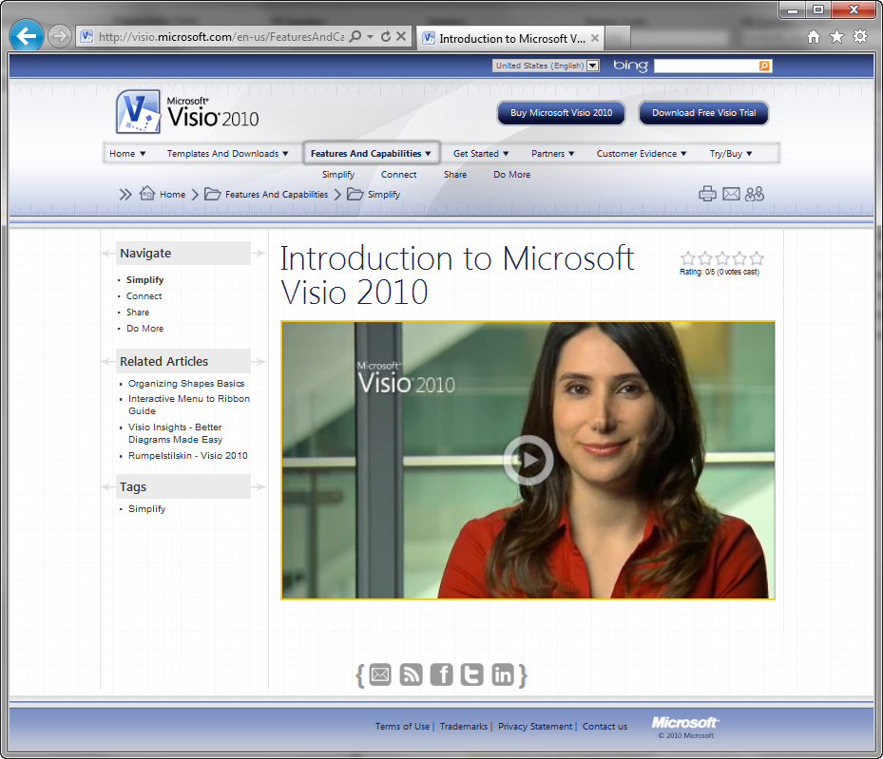
Visio Marketing Site

Slide 5
Goals
Divide and serve content via multiple user dimensions, content sections and categories
Improve content structure with an expansive ability for content reuse
Separation of content from structure allowing for easier user interface updates and redesigns in the future

Slide 6
Article & Section Pages
Article pages contain primary content and are tagged to enable viewing related articles and article roll-ups.
Related Articles: Custom CQWP showing articles with one or more tags matching this page’s tags.
Editing Section Tags: Tags are stored in a TaxonomyField exposed via the Page Layout in edit mode.
Filter By: Custom CQWP showing terms associated with the current section page.
Articles: Custom CQWP with results filtered by TaxonomyField value and a query string value.
Tags: Custom Web Part showing terms associated with the current page.
Section pages are assigned tags which are used to determine articles pages to roll-up.
Editing Tags: Tags are stored in a TaxonomyField exposed via the Page Layout in edit mode.
Notes:
Explain that section tags are first filter and filter by is second filter
Filter by looks at results of first filter to determine tags to provide for filter
Explain multilingual and use of GUID instead of label
Touch upon filter by web part and fact that it uses a label and not ID for querystring

Slide 7
Visio Marketing Site
demo
Notes:
Walk though the Visio site and show the article and section pages and how the content is rolled up.
Open each of the page types in edit mode so users can see the web parts that are in use.

Slide 8
Managed Term Store and Taxonomy Fields
Managed Metadata Overview
Taxonomy API
Taxonomy Field Values
Taxonomy Field Properties

Slide 9
Managed Metadata Overview
Service Application (Term Store)
Can associate more than one with a Web Application
Group
Collection of Term Sets
Term Set
Collection of Terms
Terms
Word or phrase used to tag data
Term Scopes
Global (scoped to Service Application)
Local (scoped to Site Collection)

Slide 10
Taxonomy API
TaxonomySession
Sets the context for the given SPSite object
TermStore
Retrieves the collection of Term Stores (1/Associated Service Application)
Stores a collection of Group objects
Group : TaxonomyItem
Accessed via TermStore.Groups property
Stores a collection of TermSet objects
TermSet : TermSetItem : TaxonomyItem
Accessed via the Group.TermSets property
Stores a collection of Term objects
Term : TermSetItem : TaxonomyItem
Accessed via the TermSet.Terms property
Represents the actual label
Alternate labels accessible via the Labels property

Slide 11
Taxonomy Field Values
Field Type (class name): TaxonomyField
TaxonomyFieldValueCollection (when allowing multiple terms) or TaxonomyFieldValue
Represented as a string:
<Term Label>|<Term ID>;
Value also stored in hidden Text field
<Original Internal Name>TaxHTField#
Internal field name length <= 32
Same value but as a string
All values stored in lookup list for performance and security reasons

Slide 12
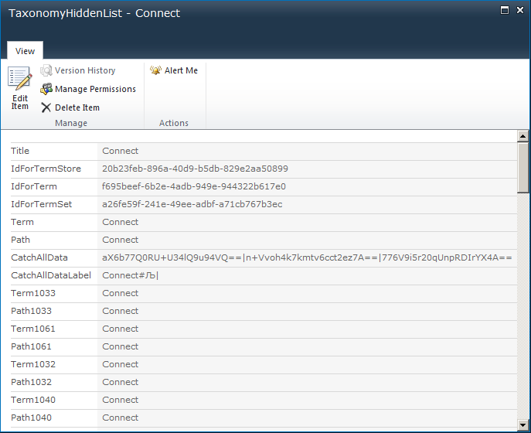
TaxonomyHiddenList
~site/Lists/TaxonomyHiddenList/
Only used items are stored
Deleting from this list will effectively clear from items using the tag

Slide 13
Taxonomy Field Properties
SspId
Corresponds to the Term Store
TermSetId
Term Set containing all the Terms for the field
AnchorId
The root TermSetItem
AllowMultipleValues
True: Field type is TaxonomyFieldTypeMulti
False: Field type is TaxonomyFieldType
var field = new TaxonomyField(web.Fields, "TaxonomyFieldTypeMulti", "FieldName");
web.Fields.Add(field);
field = (TaxonomyField)web.Fields.GetFieldByInternalName("FieldName");
field.AllowMultipleValues = true;
field.SspId = termStoreId;
field.TermSetId = termSetId;
field.AnchorId = anchorId;
field.Title = "Field Title";
field.Update();

Slide 14
Managed Term Store and Taxonomy Fields
demo
Notes:
$ts = Get-SPTaxonomySession -Site http://visio.microsoft.com
$ts | fl
$ts.TermStores
$ts.TermStores | gm
$ts.TermStores[0].GetSiteCollectionGroup
$ts.DefaultSiteCollectionTermStore.Groups
$ts.DefaultSiteCollectionTermStore.Groups["Visio Marketing Site"] | gm
$ts.DefaultSiteCollectionTermStore.Groups["Visio Marketing Site"].TermSets
$ts.DefaultSiteCollectionTermStore.Groups["Visio Marketing Site"].TermSets | gm
$ts.DefaultSiteCollectionTermStore.Groups["Visio Marketing Site"].TermSets["Tags"].Terms
$ts.DefaultSiteCollectionTermStore.Groups["Visio Marketing Site"].TermSets["Tags"].Terms | gm
$list = Get-SPList http://visio.microsoft.com/en-us/FeaturesAndCapabilities/Simplify/Pages
$list.Fields | ?{$_.InternalName -like "ArticleTags*"} | select InternalName
$list.Fields | ?{$_.InternalName -like "ArticleTags"}
$list.Items[1][$list.Fields.GetFieldByInternalName("ArticleTags").Id]
$list.Items[1][$list.Fields.GetFieldByInternalName("ArticleTags").Id].GetType().FullName
$list.Items[1][$list.Fields.GetFieldByInternalName("ArticleTags").Id].ToString()
$list.Items[1][$list.Fields.GetFieldByInternalName("ArticleTagsTaxHTField0").Id]

Slide 15
Customizing the CQWP
Why Customize the CQWP?
Manipulating CQWP Data

Slide 16
Why Customize The CQWP?
Can’t handle Multi-choice Taxonomy Fields when not scoped to a List
These fields must be added programmatically
CommonViewFields, DataMappings , DataMappingViewFields, etc., does not work when trying to retrieve field values
TaxonomyField filter values must be a GUID
Makes testing difficult
Can impact SEO
Can impact deployment/migration scenarios
Needed additional information for many result sets
Calculated information such as ratings is required for sorting
All the power of the CQWP without any of the browser-based customizations

Slide 17
Manipulating CQWP Data
Section Content Query Web Part
Set Properties
DataTable
DataTable
DataRow: ~site/Pages/Article1.aspx
Title
Summary
Thumbnail
DataRow: ~site/Pages/Article1.aspx
Title
Summary
Thumbnail
ArticleTags
Ratings
base.FilterField1 = "<field name>";
base.FilterType1 = "TaxonomyFieldTypeMulti";
base.FilterValue1 = filter;
base.ProcessDataDelegate =
new ProcessData(ProcessItems);
When setting filter values for taxonomy fields you must have a label and a GUID:
<Label>|<GUID>; <Label>|<GUID>;
string filter = HttpContext.Current.Request.QueryString["Filter1"];
TaxonomySession ts = new TaxonomySession(Context.Current.Site);
TermCollection terms = ts.GetTerms(filter, true, StringMatchOption.ExactMatch, 1, true);
if (terms.Count > 0) {
filter += TaxonomyField.TaxonomyGuidLabelDelimiter + terms[0].Id.ToString();
}
protected override void OnLoad(EventArgs e) {
base.OnLoad(e);
this.ProcessDataDelegate = new ProcessData(ProcessItems);
}
protected virtual DataTable ProcessItems(DataTable dt) {
//TODO: Process items
}
OnLoad
Process Query
DataRow: ~site/Pages/Article2.aspx
Title
Summary
Thumbnail
ArticleTags
Ratings
DataRow: ~site/Pages/Article2.aspx
Title
Summary
Thumbnail
ProcessData delegate

Slide 18
Customizing the Content by Query Web Part
demo
Notes:
Show the base class
Show the section class
Show the filter by class
Show the related articles class

Slide 19
Summary
Terms aren’t just for Intranets!
Using Terms to “tag” content can provide lots of benefits
The CQWP is extremely powerful and can easily be extended to add power and versatility
Watch out for migration and deployment issues!

Slide 20
About Aptillon
SharePoint MVPs
Microsoft Certified Master
Consultants, Trainers, Authors, Speakers, Bloggers
Great People, Great Experience, Great Passion
Todd Baginski
David Mann
Gary Lapointe
Darrin Bishop
Maurice Prather
Dan Holme
Matthew McDermott

Slide 21
Questions?

