Slide 1
STSADM
Gary Lapointe, Senior Consultant, Statêra Inc.
Microsoft Office SharePoint Server MVP

Slide 2
Agenda
What is STSADM?
Usage Tips & Best Practices
Some Common Commands
Extending STSADM
Development Best Practices

Slide 3
What is STSADM?
An extensible command line interface for administering SharePoint
Not limited to administrative needs – can be extremely helpful to developers
Easier than PowerShell
But start learning PowerShell if you want to be prepared for vNext
Contains ~186 commands OOTB
My extensions add 131 additional commands

Slide 4
Usage Tips & Best Practices
Use an install script to configure your farm using psconfig and stsadm
Allows setting of options that can’t be done via the PSConfig wizard or the browser
Configurations are self-documenting
Easier to replicate configurations between various environments
Make sure you are running as your SharePoint Administrator/Setup account (spadmin)
It’s generally a good idea to disable this account when not needed for administrative tasks

Slide 5
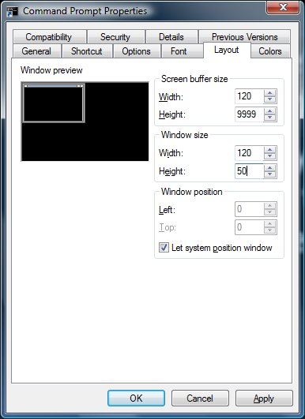
Usage Tips & Best Practices
Add the 12 hive’s bin folder to your PATH environment variable
Configure the layout properties of the console window to make it easier to view the history of long running operations
Enable Quick Edit in the Options tab

Slide 6
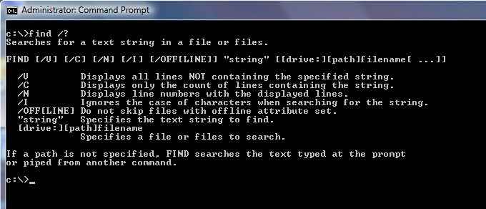
Usage Tips & Best Practices
Use the FIND command to help locate unfamiliar commands:
stsadm -help | find “ecs” /I /N
Finds Excel Services related commands
stsadm -help | find “gl-”
Finds all my custom commands

Slide 7
activatefeature
activateformtemplate
addalternatedomain
addcontentdb
adddataconnectionfile
add-ecsfiletrustedlocation
add-ecssafedataprovider
add-ecstrusteddataconnectionlibrary
add-ecsuserdefinedfunction
addexemptuseragent
addpath
addpermissionpolicy
addsolution
addtemplate
adduser
addwppack
addzoneurl
allowuserformwebserviceproxy
allowwebserviceproxy
associatewebapp
authentication
backup
backuphistory
binddrservice
blockedfilelist
canceldeployment
changepermissionpolicy
copyappbincontent
createadminvs
createcmsmigrationprofile
creategroup
createsite
createsiteinnewdb
createssp
createweb
databaserepair
deactivatefeature
deactivateformtemplate
deleteadminvs
deletealternatedomain
deletecmsmigrationprofile
deleteconfigdb
deletecontentdb
deletegroup
deletepath
deletepermissionpolicy
deletesite
deletesolution
deletessp
deletessptimerjob
deletetemplate
deleteuser
deleteweb
deletewppack
deletezoneurl
deploysolution
deploywppack
disablessc
displaysolution
editcmsmigrationprofile
editcontentdeploymentpath
editssp
email
enablecmsurlredirect
enablessc
enumalternatedomains
enumcontentdbs
enumdataconnectionfiledependants
enumdataconnectionfiles
enumdeployments
enumexemptuseragents
enumformtemplates
enumgroups
enumroles
enumservices
enumsites
enumsolutions
enumssp
enumssptimerjobs
enumsubwebs
enumtemplates
enumusers
enumwppacks
enumzoneurls
execadmsvcjobs
export
extendvs
extendvsinwebfarm
forcedeletelist
formtemplatequiescestatus
getadminport
getdataconnectionfileproperty
getformsserviceproperty
getformtemplateproperty
getproperty
getsitedirectoryscanschedule
getsitelock
getsiteuseraccountdirectorypath
geturlzone
grantiis7permission
import
installfeature
listlogginglevels
listregisteredsecuritytrimmers
localupgradestatus
managepermissionpolicylevel
mergecontentdbs
migrateuser
osearch
osearchdiacriticsensitive
preparetomove
profilechangelog
profiledeletehandler
provisionservice
quiescefarm
quiescefarmstatus
quiesceformtemplate
reconvertallformtemplates
refreshdms
refreshsitedms
registersecuritytrimmer
registerwsswriter
removedataconnectionfile
removedrservice
remove-ecsfiletrustedlocation
remove-ecssafedataprovider
remove-ecstrusteddataconnectionlibrary
remove-ecsuserdefinedfunction
removeexemptuseragent
removeformtemplate
removesolutiondeploymentlock
renameserver
renamesite
renameweb
restore
restoressp
retractsolution
retractwppack
runcmsmigrationprofile
runcontentdeploymentjob
scanforfeatures
setadminport
setapppassword
setbulkworkflowtaskprocessingschedule
setconfigdb
setcontentdeploymentjobschedule
setdataconnectionfileproperty
setdefaultssp
set-ecsexternaldata
set-ecsloadbalancing
set-ecsmemoryutilization
set-ecssecurity
set-ecssessionmanagement
set-ecsworkbookcache
setformsserviceproperty
setformtemplateproperty
setholdschedule
setlogginglevel
setpolicyschedule
setproperty
setrecordsrepositoryschedule
setsearchandprocessschedule
setsharedwebserviceauthn
setsitedirectoryscanschedule
setsitelock
setsiteuseraccountdirectorypath
setsspport
setworkflowconfig
siteowner
spsearch
spsearchdiacriticsensitive
sync
syncsolution
trimauditlog
unextendvs
uninstallfeature
unquiescefarm
unquiesceformtemplate
unregistersecuritytrimmer
unregisterwsswriter
updateaccountpassword
updatealerttemplates
updatefarmcredentials
upgrade
upgradeformtemplate
upgradesolution
upgradetargetwebapplication
uploadformtemplate
userrole
verifyformtemplate
Notes:
Go over a few of the more popular commands during the demo. Illustrate the use of the security related commands with a password change script.

Slide 8
gl-addaudiencerule
gl-addavailablesitetemplate
gl-addeventreceiver
gl-addlist
gl-addlistitem
gl-addlistviewwebpart
gl-addnavigationnode
gl-addsearchrule
gl-addsiteadmin
gl-adduser2
gl-adduserpolicyforwebapp
gl-applytheme
gl-applyupgradeareaurlmappings
gl-backup
gl-backupsites
gl-connecttoportalsite
gl-convertsubsitetositecollection
gl-copycontenttypes
gl-copylist
gl-copylistitem
gl-copylistsecurity
gl-copynavigation
gl-createaudience
gl-createcontentdb
gl-createpublishingpage
gl-createquotatemplate
gl-createsearchscope
gl-createsiteindb
gl-createwebapp
gl-deleteallusers
gl-deleteaudience
gl-deleteeventreceiver
gl-deletelist
gl-deletelistfield
gl-deletelistitem
gl-deletelistview
gl-deleteweb2
gl-deletewebapp
gl-disableuserpermissionforwebapp
gl-editprofileproperty
gl-editquotatemplate
gl-enableuserpermissionforwebapp
gl-enumaudiencerules
gl-enumavailablepagelayouts
gl-enumavailablesitetemplates
gl-enumeffectivebaseperms
gl-enumemailenabledlists
gl-enumeventreceivers
gl-enumfeatures
gl-enuminstalledsitetemplates
gl-enumnavigation
gl-enumpagewebparts
gl-enumprofileprivacypolicies
gl-enumprofileproperties
gl-enumtimerjobdefinitions
gl-enumunghostedfiles
gl-enumwelcomepages
gl-exportcontenttypes
gl-exportlist
gl-exportlistfield
gl-exportlistfolder
gl-exportlistitem
gl-exportlistitem2
gl-exportlistsecurity
gl-exportsitecolumns
gl-extendwebapp
gl-fixpagecontact
gl-fixpublishingpagespagelayouturl
gl-fixvariationrelationships
gl-gen2003to2007profilepropertymap
gl-getjobinfo
gl-getjobinfos
gl-getlistschemaxml
gl-import2
gl-importlist
gl-importlistfield
gl-importlistfolder
gl-importlistitem
gl-importlistsecurity
gl-importprofileproperties
gl-importsitecolumns
gl-listaudiencetargeting
gl-managecontentdbsettings
gl-migrate2003profilesto2007
gl-movesite
gl-moveweb
gl-movewebpart
gl-mysitesettings
gl-propagatecontenttype
gl-publishitems
gl-reghostfile
gl-removeavailablesitetemplate
gl-repairsitecollectionimportedfromsubsite
gl-replacefieldvalues
gl-replacewebpartcontent
gl-retargetcontentquerywebpart
gl-retargetgroupedlistingswebpart
gl-runprofileimportjob
gl-runtimerjob
gl-setallowaccesstoonlinegallery
gl-setanonymousaccess
gl-setaudiencecompilationschedule
gl-setauditsettings
gl-setjobschedule
gl-setlistcontenttypes
gl-setlocalsitedirectory
gl-setmastersitedirectory
gl-setmetadata
gl-setnavigationnodes
gl-setnavigationsettings
gl-setpictureurl
gl-setpictureurlnewpath
gl-setprofileprivacypolicy
gl-setsearchcenter
gl-setselfservicesitecreation
gl-setsitedirectoryscanviewurls
gl-setsitegeneralsettings
gl-setsitenamingformat
gl-setsspacl
gl-setusageanalysis
gl-setuserprofiledefaultaccessaccount
gl-setuserprofileimportschedule
gl-setwebpartstate
gl-sitewelcomepage
gl-tracelog
gl-unextendwebapp
gl-updatedefaultcontentaccessaccount
gl-updatelistfield
gl-updatelistview
gl-updatesearchscope
gl-updatev2tov3upgradeareaurlmappings
gl-upgrade2
Notes:
Illustrate the use of the security related commands via a password change script. Demonstrate how to use the backupsites command to backup site collections via a scheduled task.

Slide 9
Demo…

Slide 10
Extending STSADM
Implement Microsoft.SharePoint.StsAdmin. ISPStsAdmCommand
GetHelpMessage(string command)
Run(string command, StringDictionary keyValues, out string output)
For error conditions return Microsoft.SharePoint.StsAdmin.ErrorCodes
ErrorCodes.GeneralError
ErrorCodes.SyntaxError

Slide 11
Extending STSADM
GetHelpMessage is called when the user enters the following at the system prompt, where myOperation is the name of your custom operation.
stsadm -help myOperation
GetHelpMessage is also called when Run() returns SyntaxError.
The String that is returned is usually the only syntax help available to users of the command operation. So include everything that they needs to know, including the possible parameters, if any, that can be used with the operation.
Use standard syntax guidance style.
Use "[" and "]" to indicate material that is optional.
When more than one parameter can be used, use "|" to separate the alternatives.
Variables should be enclosed in "<" and ">".
The following string is automatically prepended to the return value; do not set it explicitly.
"stsadm -o command \n"
http://msdn.microsoft.com/en-us/library/microsoft.sharepoint.stsadmin.ispstsadmcommand.gethelpmessage.aspx

Slide 12
Demo…
Notes:
Build a new command to show how to change the account associated with an application pool.

Slide 13
Development Best Practices
Prefix your command names with something reasonably unique (your initials, company stock symbols, etc.)
Always provide some sort of help for the command
Validate all input parameters before using
Deploy your custom commands using a WSP
Abstract your core code into methods in case you need to repurpose it for a Feature
Use my CodePlex template as a starting place - http://www.codeplex.com/customstsadmtemplate

Slide 14
Resources
My custom extensions:
http://stsadm.blogspot.com/
Starter template to write your own extensions:
http://www.codeplex.com/customstsadmtemplate
MSDN
http://msdn2.microsoft.com/en-us/library/bb417382.aspx
Mindsharp white paper on STSADM
https://www.mindsharp.com/default.aspx?premium=downloads&file=stsadmpart1.pdf
STSADM command line reference
http://www.wssdemo.com/Lists/stsadm/AllItems.aspx
Inside SharePoint 2007 Administration
http://www.courseptr.com/ptr_detail.cfm?&isbn=978%2D1%2D58450%2D601%2D0

Slide 15
Questions?

