Slide 1
Sub-site or Site Collection?
IW265
Gary Lapointe, MVP
Jason Medero, MVP

Slide 2
Jason Medero, SharePoint Architect, Author, MVP
B&R Business Solutions
www.bandrsolutions.com
jmedero@bandrsolutions.com
Gary Lapointe, Senior Consultant, MVP
Statêra
http://www.statera.com
gary.lapointe@statera.com
Blog: http://stsadm.blogspot.com/

Slide 3
Agenda
Site Collections vs. Sub-Sites – considerations, pros, cons, and best practices
There can be only one
Techniques for making multiple site collections “appear” as one homogenous site
Dealing with change
Converting to or from site collections
Notes:
1. Remind people that best practices should always be considered situational.

Slide 4
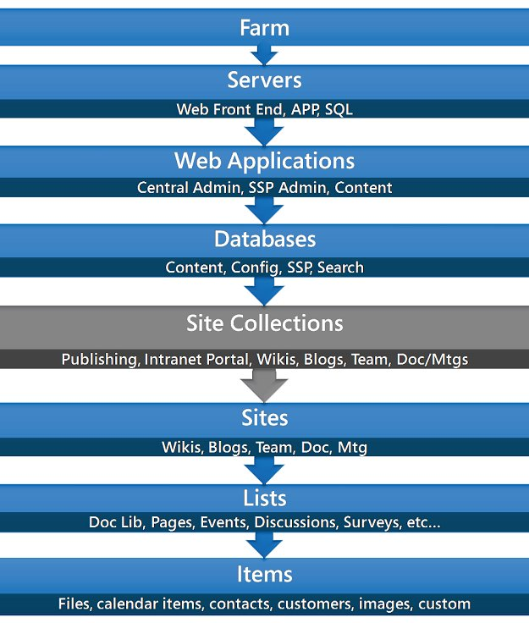
Site Collections vs. Sub-Sites

Slide 5
Considerations
Scalability
Upgrade Scope
Backup/Restore
Security
Search Settings
Audit/IRM Settings
Feature Scope
Recycle Bin
Usage Reporting
Branding*
Navigation*
Content Rollup and Aggregation*
Content Type / Site Column Scope*
Notes:
Also: Caching and Variations
(*) Will cover in next section

Slide 6
Scalability
The single most critical reason for using multiple site collections is scalability
Limit content databases to 100GB
If you must go over 100GB then use only 1 site collection in the content database
You will encounter performance issues and possibly deadlock conditions
Split content approaching 100GB in a site collection into a new site collection in a separate content database (STSADM)
Watch out for the second stage recycle bin!
Notes:
Plan for Software Boundaries: http://technet.microsoft.com/en-us/library/cc262787.aspx
The second stage recycle bin is discussed later so don’t spend any time on it here.
Site collections CANNOT live across content databases
Web applications can have multiple content databases attached to them

Slide 7
Upgrade Scope
2003 -> 2007 smallest unit of upgrade was Site Collection
No reason to suspect this will change with O14
If a sub-site proves problematic during upgrade then the upgrade of all other sub-sites in the site collection is blocked
Notes:
Gradual upgrades affected the most (lose the benefit/option of a gradual upgrade if everything is in one site collection)
From 2003->2007 the root site collection had to be upgraded before any others (in a gradual upgrade) – if the root site collection is really large with numerous sub-sites and custom Features and Site Definitions then the upgrade of the entire web application could be significantly delayed.

Slide 8
Backup/Restore
Full fidelity backups are only possible at the site collection level
If a sub-site needs to be restored then the entire site collection must be restored
STSADM export/import can be used once the site collection has been restored
Cannot restore recycle bin, workflows, alerts, personalization settings, auditing data
3rd party solutions offer full fidelity recovery at more granular levels

Slide 9
Security
Site Collections allow security groups and permissions to be isolated from other site collections
Management is more complex with site collections
Difficult to see what access a user has across site collections
No OOTB way to synchronize settings across site collections
Avoid breaking inheritance where possible
May result in unforeseen/undesirable consequences
Site collections can reduce the need to break inheritance
For large deployments Site Collections can be used to overcome SharePoint group limitations
Cannot go over 2000 users or AD groups in a single ACL
Notes:
Plan for Software Boundaries: http://technet.microsoft.com/en-us/library/cc262787.aspx

Slide 10
Search Settings
Search Scopes are defined at the site collection level
You can create shared scopes via the SSP but they must be “activated” at each site collection
Best bets and keywords are site collection scoped
Use a single search center
Settings must be manually (or programmatically) synchronized across site collections

Slide 11
Auditing/IRM
Policies can be created at the site collection scope
Compliance and regulatory requirements can be enforced in a consistent fashion
No built-in mechanism for synchronizing policies across site collections
Will have to be done manually or programmatically

Slide 12
Feature Scope
Features can be scoped to a Site Collection or Web (or Farm or Web Application)
You can prevent access to certain functionality by using site collections
Some Features must be scoped to a site collection
You might have to activate a Feature thereby (potentially) making functionality available to all users/contributors/designers of a site
Notes:
(JM)-Provide a brief overview of what features are before jumping into this slide so that we don’t lose the audience.

Slide 13
Recycle Bin
Each site collection has a first and second stage recycle bin
First stage counts towards the quota
Second stage does not count towards the quota
Be aware of the defaults – 30 days in the first stage and 50% of the site quota for the second stage
If there’s no quota then the second stage will grow infinitely
For large sites change the 2nd stage to ~20%
This will reduce the amount of additional data over the recommended 100gb allotment

Slide 14
Usage Reporting
Usage reports are scoped at the site collection
There is no out of the box mechanism to get cross site collection usage reports
SSP administrators can get search query reports which span site collections
Many 3rd party products produce much more useful/sophisticated reports for cross site collection reporting

Slide 15
There can be only one!
Notes:
Lead in slide – intentionally left blank.

Slide 16
Consistent Navigation
SPXmlContentMapProvider
Custom SiteMapProvider
Uses an XML file to store the navigation
Easy to implement
Navigation is hard coded
Changes should be deployed via a Feature
Does not support security trimming or audience targeting
Can get the navigation from a “source” site or list
Requires a lot of custom code
Could support security trimming or audience targeting
Notes:
Sahil Malik: http://blah.winsmarts.com/2008-1-Implementing_Consistent_Navigation_across_Site_Collections.aspx
Robert Bogue: http://www.thorprojects.com/blog/archive/2008/12/03/adding-a-second-global-navigation-to-pages-in-sharepoint.aspx
Faraz Khan: http://faraz-khan.blogspot.com/2008/11/writing-custom-navigation-provider-for.html
Could possibly use a web page to return XML using the PortalSiteMapProvider and then use that

Slide 17
Branding
Masterpages and CSS can be used to enforce a consistent branding experience
Use Themes for as much as possible so that the application/system pages will be branded
Use Feature Stapling to automatically apply the branding
This provides a seamless experience for the end-user
Notes:
Explain what feature stapling is to audience.

Slide 18
Content Aggregation
Out-of-box
Search Results Web Part for cross site collection
Content Query Web Part or Data Form Web Part for single site collection
3rd Party
Many different options
Example: Lightning Conductor Web Part
Custom
Make sure you load test (users and content)!
Notes:
http://www.devcow.com/blogs/jdattis/archive/2007/04/17/SharePoint-2007-How-to-Rollup-Content-from-multiple-Site-Collections.aspx

Slide 19
Content Types / Site Columns
Use Features to deploy to multiple Site Collections
If Features aren’t an option then use my custom STSADM command or your own custom code
gl-copycontenttypes (does not sync)
Important that the Content Type ID remains the same – creation via the browser does not allow setting the ID
Notes:
(JM) Provide a brief explanatioin of terminology (content types and site columns)
Features are the best way to ensure a consistent roll-out of your content types across site collections and even different farms. It’s also the only way to guarantee that the ContentTypeID remains consistent (see below).
For a production environment use Features – my gl-copycontenttypes command is most useful when trying to do a quick POC in a development or test environment - don’t rely on it for managing a production environment.
Using Features to deploy a Content Type is the only way to ensure that the Content Type ID is the same.
This is important because some web parts reference Content Types by ID and not name – issues related to this are most prevalent in a content migration scenario.

Slide 20
Cross-Site Configurator
Solution Accelerator from MSFT
http://www.codeplex.com/SPConfigurator
The tool automates the process of deploying site settings in all or selected sites in a server farm:
Applying Master Pages across a SharePoint server farm.
Setting up Web Titles for all or selected site collections across the farm.
Applying audit control settings to all or selected sites.
Adding advanced settings such as “Allow content type management” to all types of lists.
Adding a new Expiration Policy at the site collection level.
Adding a new Expiration Policy to content types, lists, and documents.
Source code is provided so you can extend for other artifacts
Notes:
There are many ways to accomplish what this tool does – view this as just one option that you can use to build your own tools
(JM) Remind the audience that tool is not supported directly by MS because it is open source.

Slide 21
PowerShell
Learn it!
You’ll need to eventually
Object pipeline makes it easy to make sweeping changes
Download Gary’s custom PowerShell Cmdlets to make working with SharePoint easier
http://stsadm.blogspot.com/2008/12/initial-release-of-my-sharepoint.html
Notes:
1. http://stsadm.blogspot.com/2008/12/initial-release-of-my-sharepoint.html

Slide 22
Dealing with Change
Notes:
Lead in slide – intentionally left blank.

Slide 23
Managing Content Databases
Remember to set the Max # of Site Collections per DB – don’t use the default
This will help to enforce the 100GB content database sizing guidelines
STSADM’s mergecontentdb command
Move a site collection from one content database to another
My STSADM gl-createsiteindb command
Allows creating a site collection in a specified database
Alternatively you must temporarily take the DB offline via Central Admin or rely on the automagically selected DB
Notes:
Also don’t forget to set the auto growth property for the database’s data file (default is 1mb – change to something like 100mb)
STSADM’s mergecontentdb: http://technet.microsoft.com/en-us/library/cc262923.aspx

Slide 24
Converting to/from Site Collections
Not a conversion but a migration
Use STSADM export/import
No workflow tasks/state
No personalization settings
No alerts
No recycle bin items
No audit information
Non-publishing sites are simple(r)
Watch out for web parts which reference lists via a GUID (DFWP!!)
Watch out for Features scoped to the site collection that may need to be activated
Publishing sites migrate with numerous errors…

Slide 25
Publishing Site Migration Errors
File not found errors on pages that map to the wrong page layout path and/or missing page layouts
Page Layouts and Settings page produces an XML parsing error*
Page Layouts do not have the correct content type assigned*
File not found errors for missing master page files
ContentType field for the Master Page Gallery library is corrupt and will need to be reset (wrong field type)*
Site collection scoped Features may need to be activated
Global Navigation will be corrupt or missing*
Web parts that use a GUID to refer to the target item will be broken
Notes:
(*) Applies to migrating to a site collection only.

Slide 26
Key Takeaways
Content database size should be number one determining factor
Use STSADM to migrate sites/site collections
Use the feature framework with solution packages
Security is dealt with at the site collection level
Plan for consistent navigation across site collections
Notes:
Remember to include two stage recycle bin when planning quotas!
Provide some example intranet scenarios with large amounts of collaboration and documents.
If an organization anticipates needing a lot of room for where collaboration is going to take place it may make sense to begin separating these collaboration spaces into their own site collections.
For example some organizations separate content sites (mostly static content or information) and collaboration sites into their own site collections. This is primarily because 150GB content database size limitation.

Slide 27
Resources
TechNet – Plan for Software Boundaries
http://technet.microsoft.com/en-us/library/cc262787.aspx
Gary’s Custom STSADM Commands
http://stsadm.blogspot.com

Slide 28
Thank you for attending!
Please be sure to fill out your session evaluation!

Slide 29
Thank you for attending!
Post conference DVD with all slide decks
Sponsored by

