Slide 1
PowerShell and SharePoint 2010
Gary Lapointe
SharePoint MVP
Notes:
#DEMO: Get-Command, Get-Member
#Display the help for the Get-Command cmdlet
help get-command
#Get a listing of all the SharePoint cmdlets
gcm -pssnapin Microsoft.SharePoint.PowerShell
#Store a listing of all the SharePoint cmdlet definitions in a text file sorted by noun
gcm -pssnapin Microsoft.SharePoint.PowerShell | sort noun | select Definition | Set-Content c:\cmds.txt
#Get just the SPService related cmdlets
gcm -noun SPService*
#We can also use multiple wildcards
gcm *SPService*
#Return just the syntax of a cmdlet
gcm Get-SPServiceApplicationPool -syntax
#Display the help for the Get-SPServiceApplicationPool cmdlet
help Get-SPServiceApplicationPool
#Get a listing of all the application pools
Get-SPServiceApplicationPool
#See all the available methods and properties
Get-SPServiceApplicationPool | gm
#Return back the actual ID shown in IIS
Get-SPServiceApplicationPool | select Id, Name
#DEMO: PowerShell Threading
#Retrieve the current thread settings
$host.Runspace.ThreadOptions
#Create a utility function to quickly get the current thread Id
function Get-ThreadId { [Threading.Thread]::CurrentThread.ManagedThreadId }
#Get the thread ID three times using three lines
Get-ThreadId
Get-ThreadId
Get-ThreadId
#Get the thread ID three times in one line
Get-ThreadId;Get-ThreadId;Get-ThreadId
#DEMO: Maintenance cmdlets
#Show the help for Get-SPLogEvent
help Get-SPLogEvent
#Get all events for a Correlation ID
Get-SPLogEvent | where {$_.Correlation -eq "fb72b45e-2ef2-43c8-971b-030c360633b"}
#Test a content database
Test-SPContentDatabase SharePoint_Content_Portal1 -ShowRowCounts
#Enable the developer dashboard
$dash = [Microsoft.SharePoint.Administration.SPWebService]::ContentService.DeveloperDashboardSettings
$dash.DisplayLevel = "OnDemand"
$dash.TraceEnabled = $true
$dash.Update()
#DEMO: Reporting
#Get Usage for a set of site collections—shows a collection for usage
Get-SPSite | Select URL, Usage
#Use a calculate property to “reach inside” the Usage property to get a specific value
Get-SPSite | Select URL, @{Expression={$_.Usage.Storage}}
#Make it cleaner with titles and formatting
Get-SPSite | Select URL, @{Name="Storage"; Expression={"{0:N2} GB" -f ($_.Usage.Storage/1GB)}}
#Then do something with the data! This new "object" is still pipelineable and actionable (here with GridView)
Get-SPSite | Select URL, @{Name="Storage"; Expression={"{0:N2} GB" -f ($_.Usage.Storage/1GB)}}, @{Name="Quota"; Expression={"{0:N2} GB" -f ($_.Quota.StorageMaximumLevel/1GB)} } | Out-GridView -Title "Sites w/Usage"
#Get all the installed features
Get-SPFeature
#Get all the features installed for a specific scope
Get-SPFeature | Where { $_.Scope –eq "Web" }
#Get information about a specific feature
Get-SPFeature ContentTypeHub | select *
#Get all enabled features for a specific scope
Get-SPFeature -Site http://portal
#Launch the AuditReport.ps1 script file in the editor
powershell_ise .\AuditReport.ps1
#Display all users and their permissions for http://portal
. .\AuditReport.ps1 -includeitems:$false -url http://portal

Slide 2
About Me
SharePoint MVP
Blog: http://stsadm.blogspot.com/
Email: gary@thelapointes.com
Twitter: @glapointe

Slide 3
Agenda
SharePoint PowerShell 2010 Basics
SharePoint PowerShell 2010 Advanced Stuff
Usage Scenarios
Remoting
Building Custom Cmdlets

Slide 4
SharePoint PowerShell 2010 Basics
Getting started

Slide 5
STSADM/PSConfig???
They’re still there but the use of them has been, for the most part, made obsolete
Everything you can do with them can be done with PowerShell (and faster)
You can access them via the PowerShell console (but why would you?)
Extensions to STSADM are still supported (just recompile and fix any necessary bugs related to API changes)

Slide 6
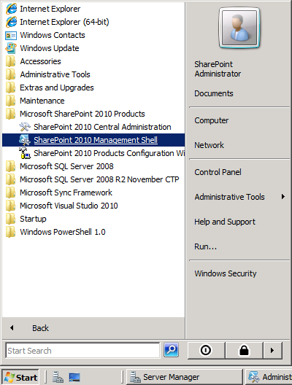
Management Shell
C:\Windows\System32\WindowsPowerShell\v1.0\PowerShell.exe -NoExit " & ' C:\Program Files\Common Files\Microsoft Shared\Web Server Extensions\14\CONFIG\POWERSHELL\Registration\sharepoint.ps1 ' "

Slide 7
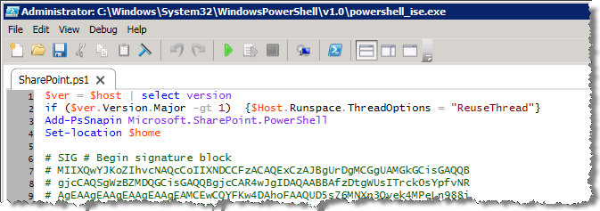
Registering the Cmdlets
Add-PsSnapin Microsoft.SharePoint.PowerShell
Registers all the SharePoint cmdlets
$Host.Runspace.ThreadOptions = “ReuseThread”
Each line runs in the same thread (V2 only)
More on this later…

Slide 8
Load Snap-in For any Editor
Loading the SharePoint snap-in via your profile script allows you to use any editor
Run the following to create a profile script if one doesn’t exist and edit it in the ISE:
if (!(test-path $profile.AllUsersAllHosts)) {new-item -type file -path $profile.AllUsersAllHosts -force}
powershell_ise $profile.AllUsersAllHosts
Add the following code to the script file and save your changes:
$ver = $host | select version
if ($ver.Version.Major -gt 1) {$host.Runspace.ThreadOptions = "ReuseThread"}
if ((Get-PSSnapin "Microsoft.SharePoint.PowerShell" -ErrorAction SilentlyContinue) -eq $null) {
Add-PSSnapin "Microsoft.SharePoint.PowerShell"
}

Slide 9
Required Permissions
Member of WSS_ADMIN_WGP and SharePoint_Shell_Access
WSS_ADMIN_WPG is a local security group on the machine the user is executing commands on
SharePoint_Shell_Access is a SQL Role in the Configuration Database
Use Add-SPShellAdmin to add a user to these groups
Add-SPShellAdmin -UserName domain\user
Get-SPDatabase | where {$_.Name -eq "SharePoint_Content_*"} | Add-SPShellAdmin -UserName domain\user
Some commands (such as setup commands) require the user to be a local server admin but most do not.
Notes:
http://sharepoint.microsoft.com/blogs/zach/default.aspx

Slide 10
Finding What You Need
Get-Command (gcm)
gcm –pssnapin Microsoft.SharePoint.PowerShell
gcm –noun SPService*
gcm *SPService*
Get-Member (gm)
$site | gm
$site | gm –Member Properties

Slide 11
Tips
To get exact syntax use “gcm [cmdlet name] –syntax”
Use Reflector to find more complex things
Watch for Feature Dependencies preventing cmdlets from being loaded (especially important for scripted build outs):

Slide 12
Using Get-Command and Get-Member
DEMO

Slide 13
PipeBind Objects
Allows different representations of an artifact to be passed into cmdlets
Example: SPSitePipeBind accepts either a GUID, URL, or SPSite object
Get-SPWeb [-Identity <SPWebPipeBind>] [-AssignmentCollection <SPAssignmentCollection>] [-Confirm [<SwitchParameter>]] [-Filter <ScriptBlock>] [-Limit <String>] [-Regex <SwitchParameter>] [-Site <SPSitePipeBind>] [-WhatIf [<SwitchParameter>]] [<CommonParameters>]
$site = Get-SPSite "http://portal"
$webs = $site | Get-SPWeb
$webs = $site.ID | Get-SPWeb
$webs = "http://portal" | Get-SPWeb

Slide 14
SharePoint PowerShell 2010 Advanced Topics
Threading and object disposal

Slide 15
PowerShell Threading
Default behavior (V1 & V2): Each line, function, or script runs in its own thread
$host.Runspace.ThreadOptions == "Default"
Causes memory leaks with unreleased handles to unmanaged objects
Management Shell: Each line, function, or script runs in the same thread
$host.Runspace.ThreadOptions == "ReuseThread"
Still has potential for memory leaks but impact is much less
Notes:
function Get-ThreadId { [Threading.Thread]::CurrentThread.ManagedThreadId }

Slide 16
PowerShell Threading
DEMO

Slide 17
Handling Disposable Items
SPAssignmentCollection
Collection object that all SharePoint cmdlets can accept to store objects that must be disposed
Get-SPSite [-AssignmentCollection <SPAssignmentCollection>] [-Confirm [<SwitchParameter>]] [-Filter <ScriptBlock>] [-Limit <String>] [-WebApplication <SPWebApplicationPipeBind>] [-WhatIf [<SwitchParameter>]] [<CommonParameters>]

Slide 18
Assignment Collections
Start-SPAssignment
Start-SPAssignment [-AssignmentCollection <SPAssignmentCollection>] [-Global <SwitchParameter>] [<CommonParameters>]
Stop-SPAssignment
Stop-SPAssignment [-SemiGlobal <SPAssignmentCollection>] [-AssignmentCollection <SPAssignmentCollection>] [-Global <SwitchParameter>] [<CommonParameters>]
Three levels of assignment:
No assignment (dispose immediately)
Simple assignment (use a global store)
Advanced assignment (use a named store)
As of Beta 2 only Get-SPSite, Get-SPWeb, New-SPSite, and New-SPWeb use this disposal capability

Slide 19
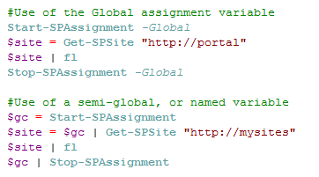
Assignment Collection Example
-Global stores items within an internal static variable
-SemiGlobal is used for named variables and can be passed via the pipeline

Slide 20
Usage Scenarios
Common cmdlets and their uses

Slide 21
Common Usage Scenarios
Farm Creation
Site Structure Creation
Service Application Setup/Configuration
Maintenance
Reporting

Slide 22
Farm Creation
Cmdlet Name | Description
New-SPConfigurationDatabase | Creates a new configuration database, and therefore a new SharePoint farm. This cmdlet is run only once per farm.
Connect-SPConfigurationDatabase | Connects a server to an existing configuration database thus adding the server to the farm. This cmdlet is run once per server in the farm after the first server is provisioned using New-SPConfigurationDatabase.
Initialize-SPResourceSecurity | Sets required file, folder, and registry ACLs for the local server. This cmdlet must be run for each server in the farm.
Install-SPService | Installs the services in the farm. This cmdlet is run once per farm (in a standalone configuration it is possible to automatically provision the services by running the cmdlet again, providing the –Provision parameter) : PS C:\> Install-SPService
Install-SPFeature | Installs all the Features available to the farm. This cmdlet is run once per farm using the -AllExistingFeatures parameter: PS C:\> Install-SPFeature -AllExistingFeatures
New-SPCentralAdministration | Provisions a central administration site on the local server. This cmdlet is typically run only once per farm but can be run on additional servers as is needed.
Install-SPHelpCollection | This optional cmdlet installs the help files that are used throughout the farm. This cmdlet is run only once per farm on the same server as the central admin site unless installing new help collections (custom or third party). Provide the -All switch when calling this cmdlet for Farm setup. PS C:\> Install-SPHelpCollection -All
Install-SPApplicationContent | This optional cmdlet installs any application content for the central administration site. This cmdlet is run only once per farm on the same server as the central administration site.

Slide 23
Farm Creation
Examine a working farm creation script
DEMO

Slide 24
Site Structure Creation
Cmdlet Name | Description
New-SPManagedAccount | Creates a new managed account which can be used when creating the application pool.
New-SPServiceApplicationPool | Creates a new application pool. Running this cmdlet does not immediately provision the application pool but simply registers the definition with SharePoint. Once the application pool is associated with a web application or service application then the application pool is provisioned.
New-SPWebApplication | Creates a new web application.
New-SPContentDatabase | Creates a new content database for a specific web application.
New-SPManagedPath | Creates a managed path under the specified web application.
New-SPSite | Creates a new Site Collection (watch for disposal issues!)
New-SPWeb | Creates a new Site within a Site Collection (watch for disposal issues!)
Set-SPDesignerSettings | Sets the actions that users can perform using SharePoint Designer.

Slide 25
Site Structure Creation
Examine a working site structure creation script
DEMO

Slide 26
Service Application Setup/Configuration
Cmdlet Name | Description
Get-SPServiceInstance | Returns back the service instances installed on the server. Use this cmdlet to check if a service instance is online prior to enabling. $svc = (Get-SPServiceInstance | Where {$_.TypeName -eq "Managed Metadata Web Service"})
Start-SPServiceInstance | The actual service instance. For most services this can be called on more than one server to provide failover and load balancing. if ($svc.Status –eq "Disabled") { $svc | Start-SPServiceInstance } while($svc.Status -ne "Online") { Write-Host -ForegroundColor Yellow "Waiting for Metadata service to provision"; sleep 5; }
New-SP*ServiceApplication | Defines the actual service definition and configurations for a service instance. Most service applications allow multiple instances per farm with different configurations and proxy group associations. PS C:\> Get-Command New-SP*ServiceApplication
New-SP*ServiceApplicationProxy | The “service connection” that allows communication with the service application. It is only necessary to run this once per service application. PS C:\> Get-Command New-SP*ServiceApplicationProxy
New-SPServiceApplicationProxyGroup Add-SPServiceApplicationProxyGroupMember | Allows service applications to be grouped. Proxy groups are then associated with one or more web applications.
*Some service applications require several additional cmdlets to complete the configuration

Slide 27
Service Applications
Examine a working Service Application setup script
DEMO

Slide 28
Maintenance
Cmdlet Name | Description
Backup-SPConfigurationDatabase Backup-SPFarm Backup-SPSite | Backup a farm, site collection or just the configuration database.
Restore-SPFarm Restore-SPSite | Restores a farm or site collection.
Test-SPContentDatabase | Tests a content database for issues such as orphaned sites, schema issues, etc.
Add-SPSolution Install-SPSolution Uninstall-SPSolution Remove-SPSolution Update-SPSolution | Cmdlets equivalent to the STSADM addsolution, deploysolution, retractsolution, deletesolution, and updatesolution.
Disable-SPFeature Enable-SPFeature | Deactivates and activates SharePoint Features.
Start-SPTimerJob | Starts a timer job.
Get-SPLogEvent | Returns information about events. Can also accept a correlation ID. The following example returns back all critical events: Get-SPLogEvent -MinimumLevel Critical | select Category, Message | ft -Wrap -AutoSize
New-SPLogFile | Ends the current log file and creates a new one. Useful for debugging issues.

Slide 29
Developer Dashboard
The developer dashboard enables you to view performance and debugging data for a given page request.
Beta2 can be enabled/disabled via either PowerShell or STSADM but you cannot interchange (if enabled using PowerShell you must disable using PowerShell)
$dash = [Microsoft.SharePoint.Administration.SPWebService]::ContentService.DeveloperDashboardSettings
$dash.DisplayLevel = "OnDemand"
$dash.TraceEnabled = $true
$dash.Update()

Slide 30
Maintaining SharePoint 2010
DEMO

Slide 31
Reporting
Cmdlet Name | Description
Get-SPFeature | Gets the features that are installed or enabled at a specific scope. Use a specific scope (Farm, Site, Web) to see only those enabled.
Get-SPSite | Gets site collections. Use “-Limit All” to see all site collections and “-Filter <script block>” to filter results server side.
Get-SPWeb | Gets sites. Use “-Limit All” to see all site collections and “-Filter <script block>” to filter results server side.
Get-SPContentDatabase | Gets content databases.
Get-SPProcessAccount, Get-SPManagedAccount | Returns the accounts used by SharePoint.

Slide 32
Reporting
DEMO

Slide 33
Remoting
Remote server administration
Notes:
#Set a server variable for later use
$server = "sp2010b2.sp2010.com"
#Get the credentials to use when connecting
$cred = Get-Credential sp2010\spadmin
#Start a new remote session
$session = New-PSSession $server -Authentication CredSSP -Credential $cred
#Add the SharePoint PowerShell cmdlets to the session
Invoke-Command -Session $session -ScriptBlock {Add-PsSnapin Microsoft.SharePoint.PowerShell}
#Import the session to the local computer
Import-PSSession $session -CommandType Cmdlet -WarningAction SilentlyContinue
#Get the SPFarm object
Get-SPFarm | fl
#Get an SPSite object
Get-SPSite http://portal | fl
#Try and display the same usage report from earlier
Get-SPSite | Select URL, @{Name="Storage"; Expression={"{0:N2} GB" -f ($_.Usage.Storage/1GB)}}
#Show the member information
Get-SPSite http://portal | gm

Slide 34
Remoting
PowerShell Remoting uses WinRM, Microsoft’s implementation of the WS-Management protocol
WinRM allows you to run scripts against remote servers over HTTP and HTTPS
Works with V2 only
Requires that WinRM be enabled on both the client and the server

Slide 35
Enabling Remoting
Run Enable-PsRemoting on the client and server machines
Must Enable CredSSP
Credential Security Support Provider
Allows cmdlets to talk to SQL using the provided credentials (handles the double-hop issue)
Recommended to increase the MaxMemoryPerShellMB on a designated admin server (default is 150mb)
Set-Item WSMan:\localhost\Shell\MaxMemoryPerShellMB 1000

Slide 36
Enabling CredSSP
On the Client machine
Group Policy must be edited to allow credential delegation to the target computer.
Use gpedit.msc
Computer Configuration -> Administrative Templates -> System -> Credentials Delegation -> Allow Delegating Fresh Credentials
Verify that it is enabled and configured with an SPN appropriate for the target computer (WSMAN/myserver.domain.com or WSMAN/*.domain.com)
May have to similarly enable “Allow Fresh Credentials with NTLM-only Server Authentication” if the above setting does not work
Enable-WSmanCredSSP -Role Client -DelegateComputer <remote server name>
On the server machine
Enable-WSmanCredSSP -Role Server

Slide 37
Running Remote Commands
$server = "<server name>"
$cred = Get-Credential <domain>\<user>
$session = New-PSSession $server -Authentication CredSSP -Credential $cred
Invoke-Command -Session $session -ScriptBlock {Add-PsSnapin Microsoft.SharePoint.PowerShell}
Import-PSSession $session -WarningAction SilentlyContinue
Notes:
$server = "sp2010b2.sp2010.com"
$cred = Get-Credential sp2010\spadmin
$session = New-PSSession $server -Authentication CredSSP -Credential $cred
Invoke-Command -Session $session -ScriptBlock {Add-PsSnapin Microsoft.SharePoint.PowerShell}
Import-PSSession $session -CommandType Cmdlet -WarningAction SilentlyContinue

Slide 38
Building Custom Cmdlets
Visual Studio 2010 Cmdlet Development

Slide 39
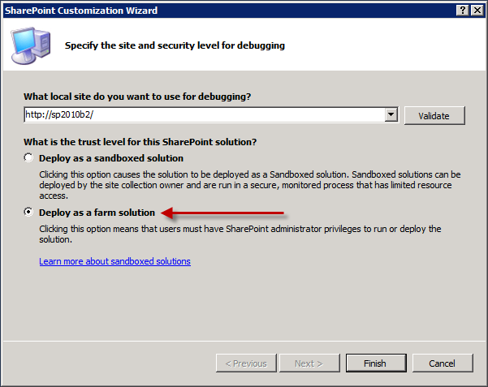
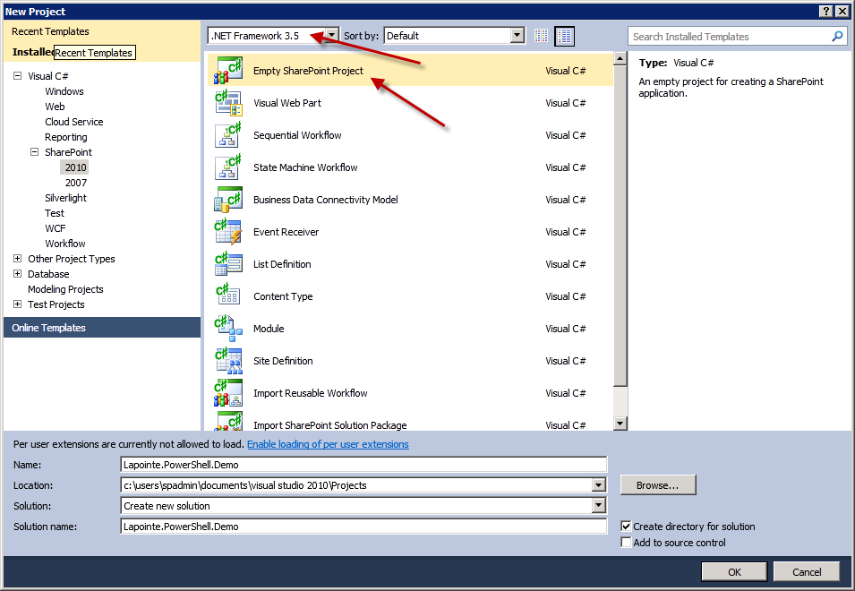
Creating a new VS2010 Project

Slide 40
Key Components
Required XML registration file defines the custom cmdlets and maps the name to the class and help file
14\Config\PowerShell\Registration\<project name>.xml
Optional XML help file
14\Config\PowerShell\Help\<dll name>-help.xml
Optional XML format file
14\Config\PowerShell\Format\<project name>.Format.ps1xml
Optional XML types file allows aliased properties to be declaratively added to existing types
14\Config\PowerShell\Types\<project name>.ps1xml

Slide 41
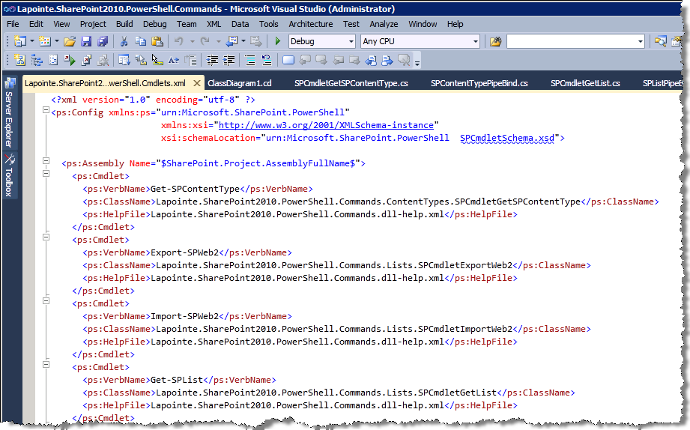
Registration XML

Slide 42
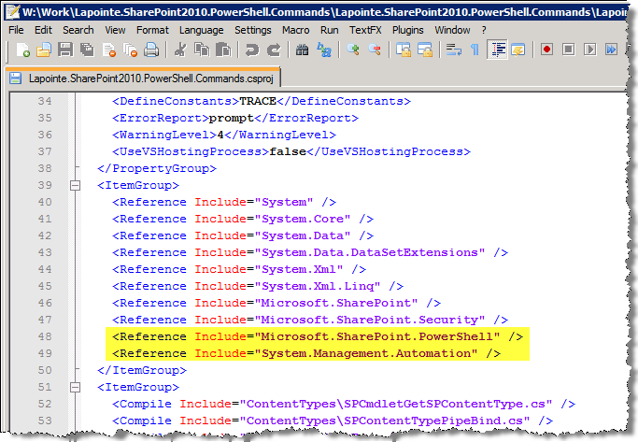
Add Required Assemblies
Add the following assembly references:
Microsoft.SharePoint.PowerShell
System.Management.Automation
VS2010 Beta 2 does not show these assemblies in the references dialog so you must either browse to them or manually edit the project file

Slide 43
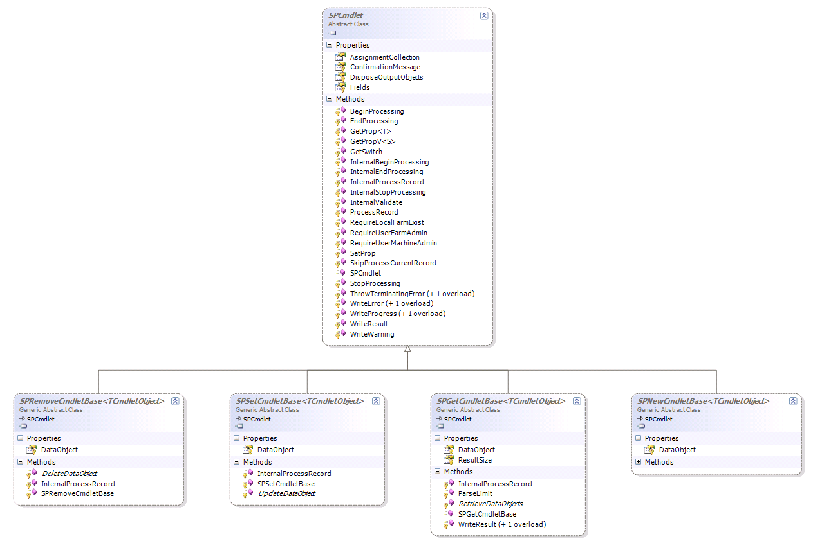
Cmdlet Base Classes
SPCmdlet
SPRemoveCmdletBase
SPSetCmdletBase
SPGetCmdletBase
SPNewCmdletBase

Slide 44
Building Custom Cmdlets
Visual Studio 2010 Cmdlet Development
DEMO

Slide 45
Key Takeaways
PowerShell is an absolute necessity for SharePoint 2010 – Learn it!
As administrators or developers you will need to know the SharePoint OM
For common, complex “building block” tasks that must be repeated many times it is better to create a custom cmdlet

Slide 46
Thank You!

